Slide 1


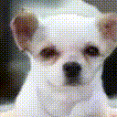
Artificial Intelligence
AI502 Deep Learning
Spectral Normalization for Generative Adversarial Networks
EuiYul Song (20214426)
November 27, 2021
Takeru Miyato1, Toshiki Kataoka1, Masanori Koyama2, Yuichi Yoshida3
1Preferred Networks, Inc. 2Ritsumeikan University 3National Institute of Informatics
Notes:
Today, I will present a paper summary and my implementation details of the publication, spectral normalization for generative adversarial networks, written by Miyato, Kataoka, Koyama, and Yoshida

Slide 2
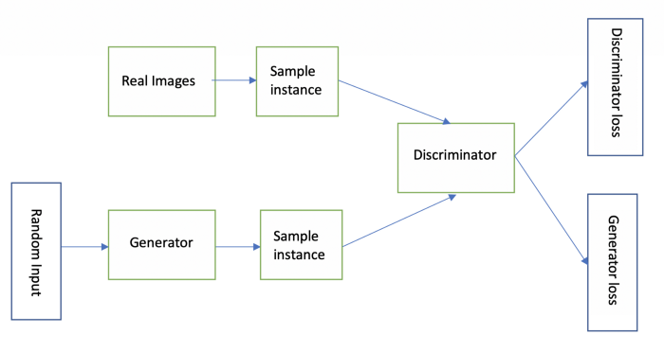

1. Introduction
Spectral Normalization for GANs
Background
GANs: produce a model distribution that mimics a given target distribution
Generator: produces the model distribution through fake images
Discriminator: distinguishes the model distribution from the target
Artificial Intelligence
AI502 Deep Learning
Notes:
I will kick off with some backgrounds of this paper first. Generative adversarial networks (GANs) have been enjoying considerable success as a framework of generative models in recent years. And it has been applied to numerous types of tasks and datasets.
In a nutshell, GANs are a framework to produce a model distribution that mimics a given target distribution. And it consists of a generator that produces the model distribution and a discriminator that distinguishes the model distribution from the target.
The concept is to consecutively train the model distribution and the discriminator in turn, with the goal of reducing the difference between the model distribution and the target distribution measured by the best discriminator possible at each step of the training.

Slide 3
1. Introduction
Spectral Normalization for GANs
Background
GANs: produce a model distribution that mimics a given target distribution
Generator: produces the model distribution through fake images
Discriminator: distinguishes the model distribution from the target
Train jointly to minimize:
discriminator output for real data generator output for fake data
Generator try to maximize the loss such that D(y) is close to 1 & D(G(x, z)) is close to 0
Discriminator try to minimize the loss such that D(G(x, z)) is close to 1
Artificial Intelligence
AI502 Deep Learning
Notes:
The discriminator and the generator are trained jointly to minimize the objective function that we have here. The Discriminator outputs likelihood in range of 0 to 1 of real image as D of y in the left part of the equation. The discriminator try to minimize the loss such that D of G of x and z is close to 1. D of G of x and z in the right part of the equation is the generator’s output for fake data. And it is try to minimize the loss such that D of G of x and z is close to 1.

Slide 4
1. Introduction
Spectral Normalization for GANs
However
Discriminator: is often in accurate and unstable during training
Generator: fail to learn the multimodal structure of the target distribution
Worst of All: a discriminator perfectly distinguish the model distribution from the target
- derivative of the this discriminator with respect to the input turns out to be 0
- the training of the generator comes to complete stop, because the 0
Spectral Normalization that can stabilize the training of discriminator networks
Therefore
Artificial Intelligence
AI502 Deep Learning
Notes:
However, a persisting challenge in the training of GANs is the performance control of the discriminator. In high dimensional spaces, the density ratio estimation by the discriminator is often inaccurate and unstable during the training. And generator networks fail to learn the multimodal structure of the target distribution. Even worse, when the support of the model distribution and the support of the target distribution are disjoint, there exists a discriminator that can perfectly distinguish the model distribution from the target. Once such discriminator is produced in this situation, the training of the generator comes to complete stop, because the derivative of the so-produced discriminator with respect to the input turns out to be 0. This motivates the authors to introduce some form of restriction to the choice of the discriminator.
Therefore, the author proposed spectral norm that can stabilize the training of discriminator networks.

Slide 5
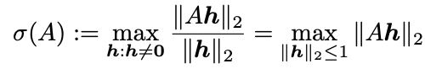
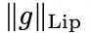
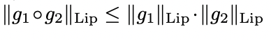
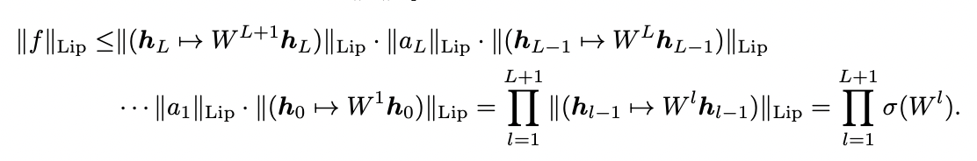
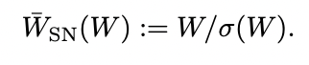
2.. Methods
Spectral Normalization for GANs
Spectral Normalization
Definition
= , where
Using Inequality ,
Spectral Norm
Artificial Intelligence
AI502 Deep Learning
Notes:
By definition, Lipchitz Norm of g is equal to spectral norm of gradient of g, where spectral norm of A has formula on the right, merely meaning a direction of largest change when perform gradient descent.
Furthermore, using inequality here, we can derive that Lipchitz norm of whole neural network is smaller or equal to multiplication of spectral norm of every layers.
Thus, the author proposed to divide weight matrix W by spectral norm, resulting in Lipchitz norm smaller than 1

Slide 6
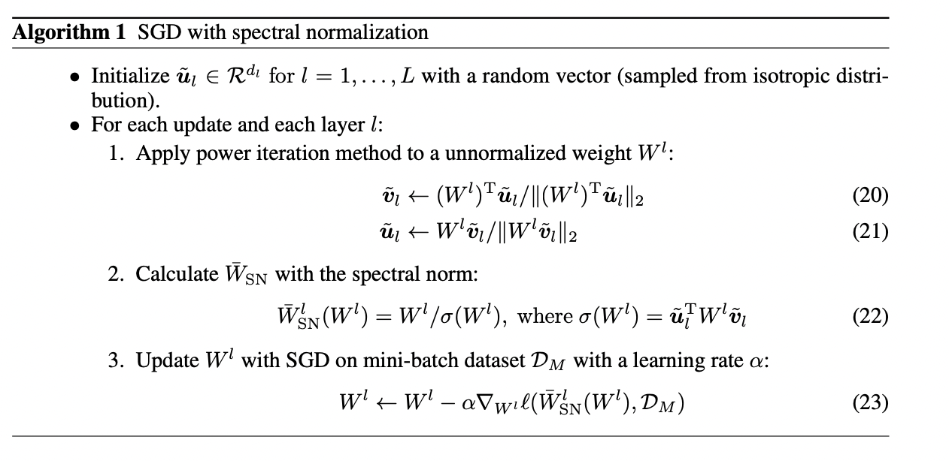
2.. Methods
Spectral Normalization for GANs
Fast Approximation
Spectral Norm: the largest singular value of W
Singular Value Decomposition is slow, so Power Iteration Method
Artificial Intelligence
AI502 Deep Learning
Notes:
As we mentioned in previous slides, the spectral norm that the authors use to regularize each layer of the discriminator is the largest singular value of W . If we naively apply singular value decomposition to compute the spectral norm at each round of the algorithm, the algorithm can become computationally heavy. Therefore, the authors proposed power iteration method.
In power iteration method, the authors begin with vectors u ̃ that is randomly initialized for each weight. Iterating each update and each layer, the authors applied power iteration method to a unnormalized weight in the layer. And calculate spectral normalization of weight using approximate on the right of equation 22. And updated W with SGD on mini-batch dataset with a learning rate alpha.

Slide 7
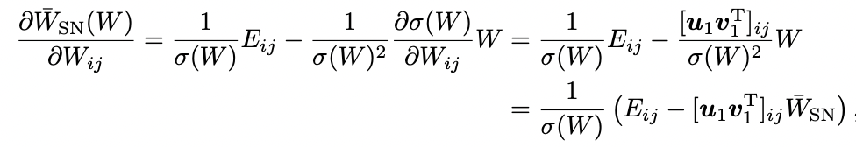
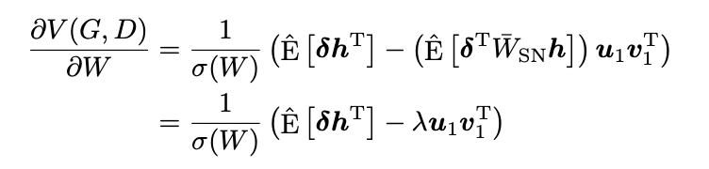
2. Methods
Spectral Normalization for GANs
GRADIENT ANALYSIS
Gradient of Spectral Norm:
Gradient of Spectral Norm:
derivative of weights. Regularization term
This reparameterization promotes the performance of GANs
Artificial Intelligence
AI502 Deep Learning
Notes:
The formula above is the gradient of weight of spectral norm with respect to weight.
If h is the hidden layer in the network to be transformed by spectral normalized weight, the derivative of the V of G and D calculated over the mini-batch with respect to W of the discriminator D is given by the formula in the middle.
The first term expectation over delta times h transposed is the same as the derivative of the weights without normalization. In this light, the second term in the expression can be seen as the regularization term penalizing the first singular components with the adaptive regularization coefficient lambda. As it turns out, this parametrization has its merit on its own and promotes the performance of GANs

Slide 8
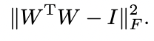
3. Comparison
Spectral Normalization for GANs
Spectral Normalization vs Other Regularization
Weight Normalization: normalizes the l2 norm of each row vector in the weight matrix
- inadvertently impose much stronger constraint on the matrix
- inadvertently diminishing the number of features in discriminators
- produce a rather arbitrary model distribution
Orthonormal Regularization: on each weight to stabilize the training GANs
-
- destroys the information by setting all the singular values to one
Gradient Penalty: placed K-Lipschitz constant on the discriminator
- computationally heavy
Artificial Intelligence
AI502 Deep Learning
Notes:
Now, I will compare spectral normalization to other regularization techniques.
First, The weight normalization is a method that normalizes the l2 norm of each row vector in the weight matrix. These normalizations, however, inadvertently impose much stronger constraint on the matrix than intended. So ,in order to make the discrimination more sensitive, one would hope to make the norm of weight matrix large. For weight normalization, however, this comes at the cost of reducing the rank and hence the number of features to be used for the discriminator. Consequently, the algorithm would produce a rather arbitrary model distribution that matches the target distribution only at select few features. Our spectral normalization, on the other hand, do not suffer from such a conflict in interest. Note that the Lipschitz constant of a linear operator is determined only by the maximum singular value. In other words, the spectral norm is independent of rank.
Second, In 2016, Brock introduced orthonormal regularization on each weight to stabilize the training of GAN using objective function here. However, orthonormal regularization destroys the information about the spectrum by setting all the singular values to one. On the other hand, spectral normalization only scales the spectrum so that its maximum will be one.
Lastly, Gradient Penalty, placed K-Lipschitz constant on the discriminator by augmenting the objective function with the regularization that rewards the function for having local 1-Lipschitz constant. However, this algorithm suffers from heavy computation time.

Slide 9
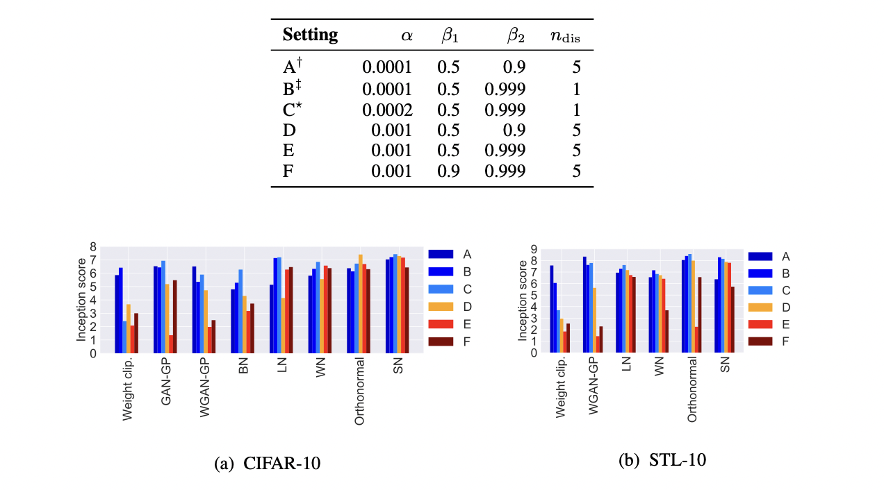
4. Experiments
Spectral Normalization for GANs
Experiments
Artificial Intelligence
AI502 Deep Learning
Notes:
So that was all the theories behind Spectral Normalization for GANs. Now, we will move on to the experiments performed by the authors. Above chart is the Hyperparameter settings that the authors tested in their experiments.
Below graphs are Inception scores on CIFAR-10 and STL-10 with different methods and hyperparameters. Here, higher inception score means better the result. Looking at the chart, we can see that spectral normalization is relatively robust with aggressive learning rates and momentum parameters, while some other techniques fail to train good GANs at high learning rates and high momentum parameters on both CIFAR-10 and STL-10. These results suggests that spectral normalization method is more robust than other methods with respect to the change in the setting of the training.

Slide 10
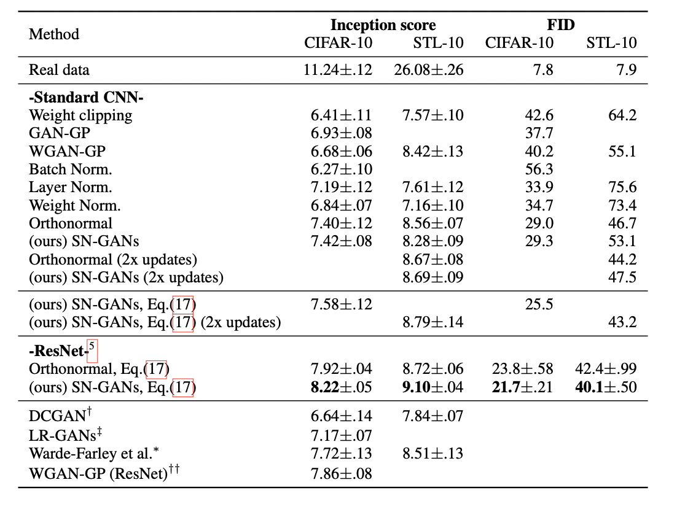
4. Experiments
Spectral Normalization for GANs
Experiments
Artificial Intelligence
AI502 Deep Learning
Notes:
This table show the inception scores of the different methods with optimal settings on CIFAR- 10 and STL-10 dataset. We see that SN-GANs performed better than almost all contemporaries on the optimal settings. SN-GANs performed even better with hinge loss.

Slide 11
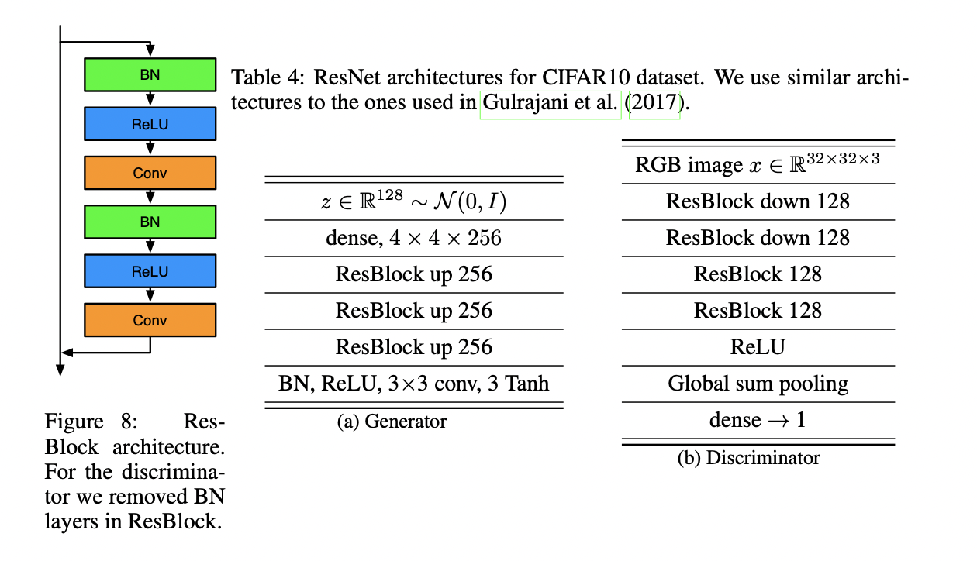
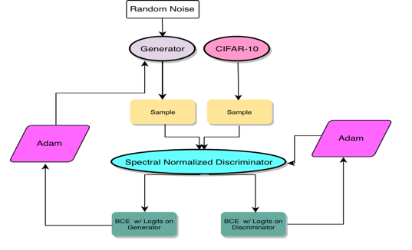
4. Experiments
Spectral Normalization for GANs
My Experiments
Artificial Intelligence
AI502 Deep Learning
Notes:
I used a standard GANs’ data flow and loss function with CIFAR-10 dataset for my implementation. However, I implemented this paper with Res-Net architectures on the right rather than CNN architecture. Succinctly, I built a Generator and discriminator with Res-Block architecture, but I added spectral normalization on res-block and dense block in my discriminator,

Slide 12
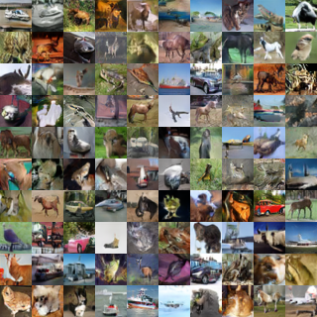
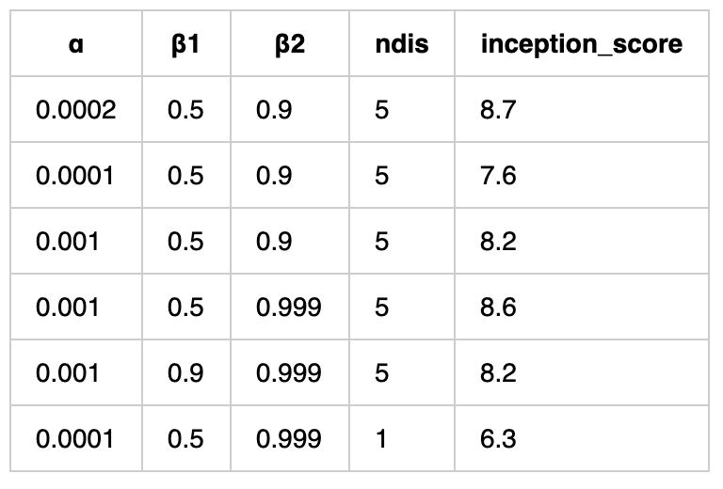
4. Experiments
Spectral Normalization for GANs
Result
Artificial Intelligence
AI502 Deep Learning
Notes:
These are the images my model produced after 300 epochs and I maintain that my spectral normalized GANs generated fake images accurately and stably, because objects depicted in the image are very intuitive that they are easy to categorize with naked eyes.
Additionally, looking at the chart on the right, my spectral normalization is relatively robust with aggressive learning rates and momentum parameters like the authors had before.

Slide 13
5. Conclusion
Spectral Normalization for GANs
Summary
Spectral Norm: stabilizer of training of GANs
- more diverse than the wight normalization
- better inception scores than other regularization techniques
- impose global regularization
https://github.com/euiyulsong/Spectral-Normalization-for-GANs
1. Why did the authors use Power Iteration methods over a Singular Value Decomposition?
2. What are some advantages of the Spectral Normalization over other regularization?
3. How did the Spectral Normalization promote the performance of GANs?
Discussions
Artificial Intelligence
AI502 Deep Learning
Notes:
I summary, this paper proposes spectral normalization as a stabilizer of training of GANs. When we apply spectral normalization to the GANs on image generation tasks, the generated examples are more diverse than the conventional weight normalization, and achieve better or comparative inception scores relative to previous studies. The method imposes global regularization on the discriminator as opposed to local regularization introduced by WGAN-GP, and can possibly used in combinations.
If you want to explore my code, please go to the URL here, and click star and fork.
These are my discussion questions for your submission on next Sunday.
So that’s the end of my presentation. Any questions?

Slide 14
5. Conclusion
Spectral Normalization for GANs
Questions?
Artificial Intelligence
AI502 Deep Learning
Notes:
So that’s the end of my presentation. Any questions?

